Slide 1
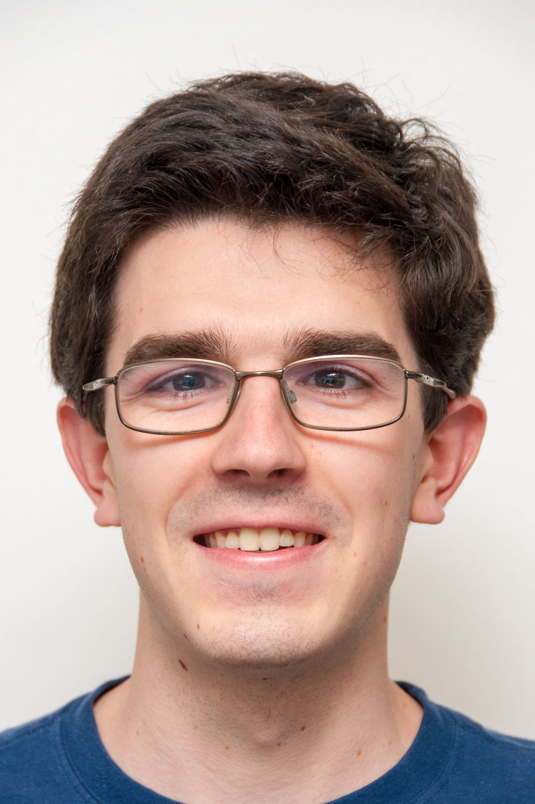


OCULUS RIFT, next “it”?
Invite your friends to take CS10 next sem!
The Beauty and Joy of Computing Lecture #25 Summary & Review
Calendar?
Slip days
Michael Ball
Head TA
Register Iclicker, then turn in during lab or dis
BJC Art or Poem Submit this at final for extra credit!
Lab this week is Survey (0:20), online final (1:30)
Facebook’s purchase of Oculus Rift is one indication that this is an incredibly HOT potential new technology. Gamers rejoice!
Discussion this week is important – course feedback + summary
oculusvr.com

Slide 2
Administrivia: Become active!
With-Snap! Exam details
No exam handed out unless you’ve filled in both HKN + our survey
No “study sheets” needed / allowed since you have access to Snap!
Final Exam details
Only bring pens, three 8.5”x11” handwritten sheets (writing on both sides).
Leave backpacks, books, calculators, cells & pagers home!
Everyone must take ALL of the final!
Bring your “Beauty and Joy of Computing” Art/Poem for extra credit!
If you did well in CS10 and want to be on staff?
Usual path: Lab Assistant  Reader  TA
Indicate on your final survey whether you’re even remotely interested
We strongly encourage anyone who gets an B or above in the class to follow this path…

Slide 3
Taking advantage of Cal Opportunities
“The Godfather answers all of life’s questions” – Heard in “You’ve got Mail”
Why are we one of the top Universities in the WORLD?
Research, research, research!
Whether you want to go to grad school or industry, you need someone to vouch for you!
…as is the case with the Mob
Techniques
Find out what you like, do lots of web research (read published papers), hit OH of Prof, show enthusiasm & initiative
http://research.berkeley.edu/
http://researchmatch.heroku.com/

Slide 4
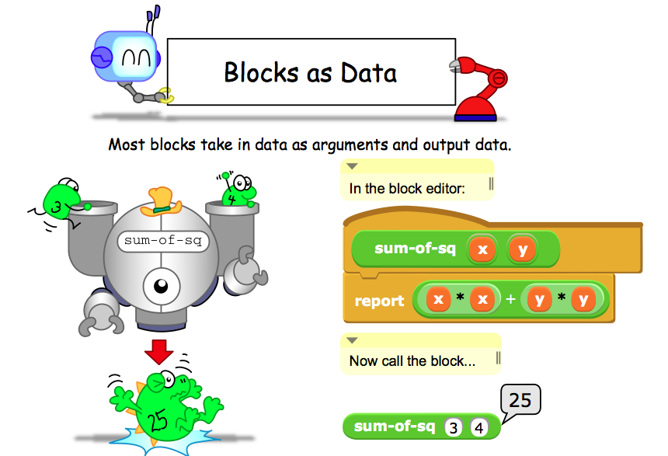
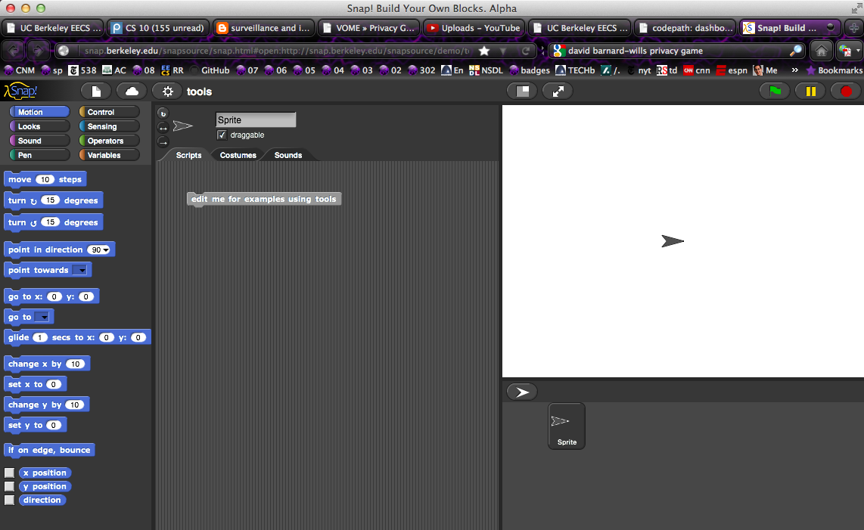
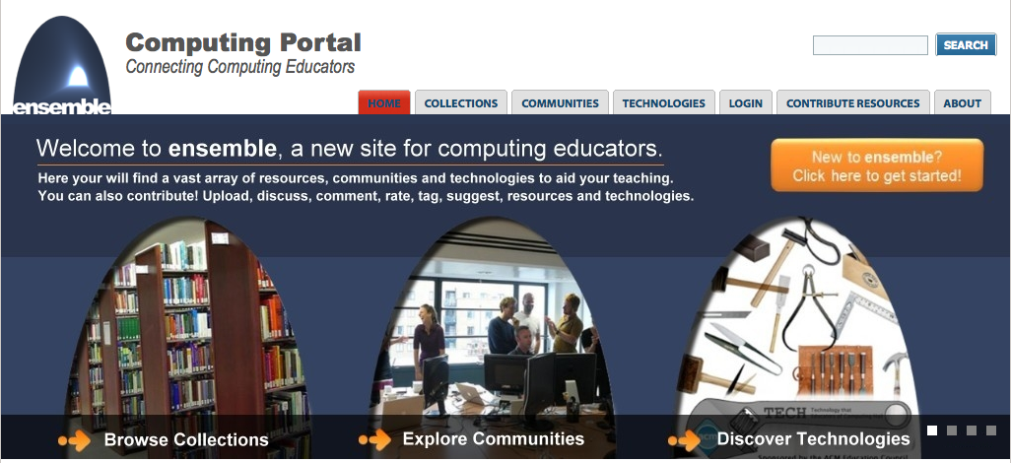
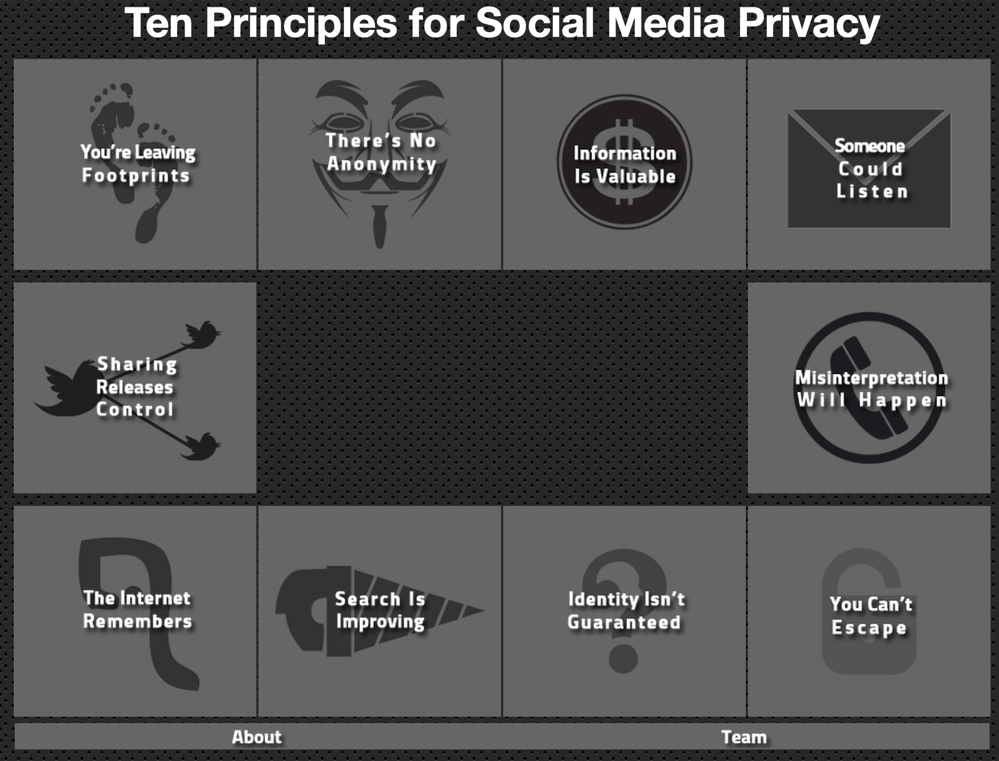
Dan’s Research Projects
CS Illustrated
Ensemble
Improve CS10/Snap!
Improve Privacy Teaching
We’ll email class about opportunities this sprig…

Slide 5
Opportunities Next Semester
CS61A (1st course in CS major)
Structure and Interpretation of Computer Programs, Python
CS9 series (learn a second language)
I would recommend Python next, CS9H
GamesCrafters DeCal (Game Theory R & D)
Develop SW, analysis on 2-person games of no chance. (e.g., go, chess, connect-4, nim, etc.)
Req: Game Theory / SW Interest
MS-DOS X DeCal (Mac Student Developers)
Learn to program Macintoshes.
Req: Interest. Owning a mac helps, not required.
UCBUGG DeCal (Recreational Graphics)
Develop computer-generated images, animations.
Req: 3D interest

Slide 6
Ok, I’m hooked! Where do I go next?
CS Major / Minor
You are here
CS61A
In Python, one big idea every week. Awesome!
CS61B
In Java, data structures, algorithms and software engineering (lite)
CS61C
In C and MIPS, Great ideas in computer architecture (parallelism) … I teach this!
CS10
CS61A
CS61B
CS61C

Slide 7
Things to remember from CS10
Abstraction
The key idea underpinning all computer science
…and (in CS10) functions, HOFs
…From Blown to Bits
Technology has social implications (privacy, energy, copyright, etc); try to see the big picture
It also often has unintended consequences!
Things are never black or white, pure good or pure evil
…From “Program or Be Programmed”
Technology has an explicit and implicit agenda, understanding it is important.
Learning to program is empowering (Steve Jobs’ video)

Slide 8
The Future for Future Cal Alumni
What’s The Future?
New Millennium
Always-on internet connectivity + internet of things!
AI breakthroughs
HCI breakthroughs
Post-PC Era (power is in cloud, interface in pocket)
“The best way to predict the future is to invent it” – Alan Kay
The Future is up to you!

Slide 9
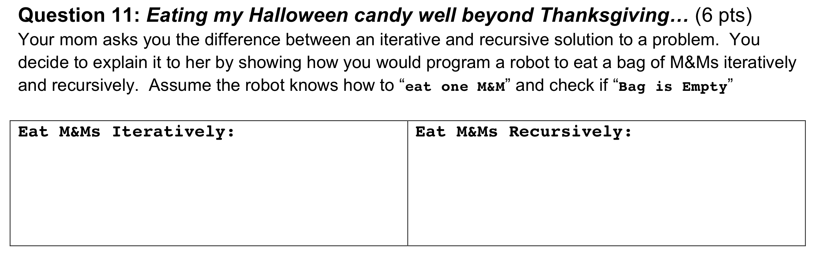
Question 11

Slide 10
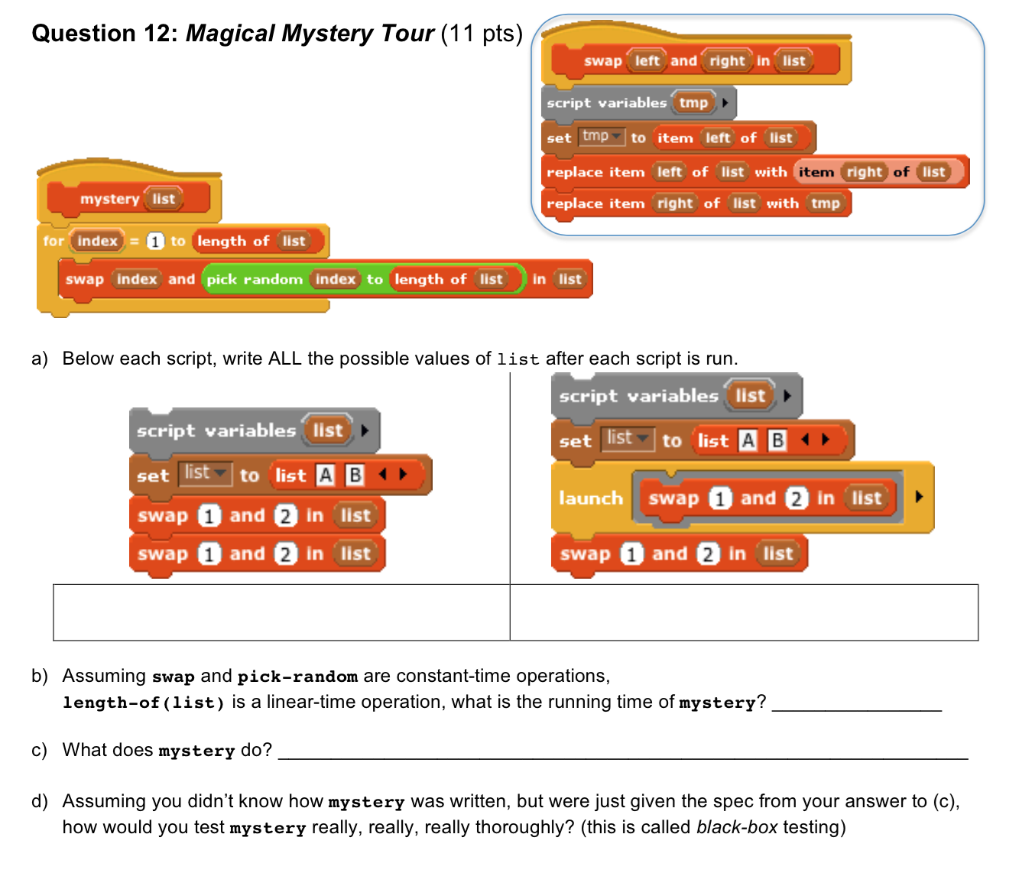

Slide 11
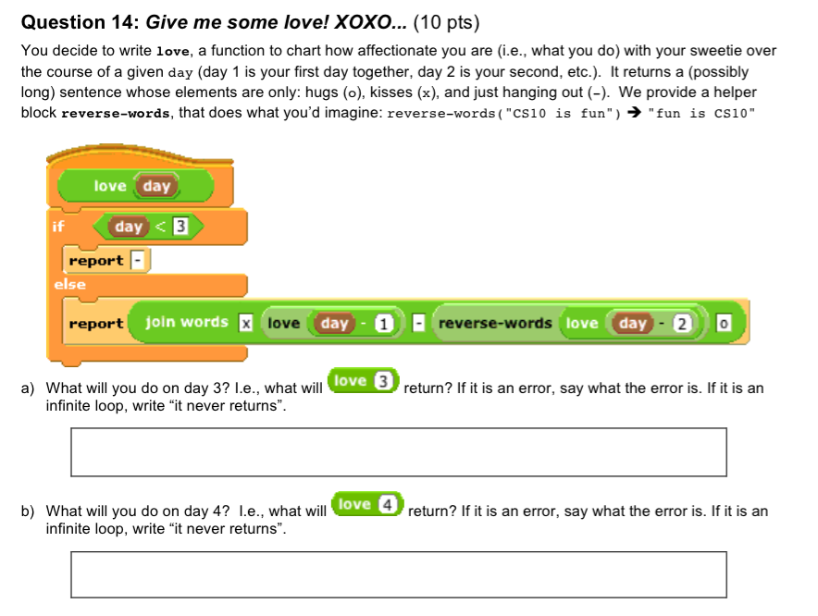

Slide 12
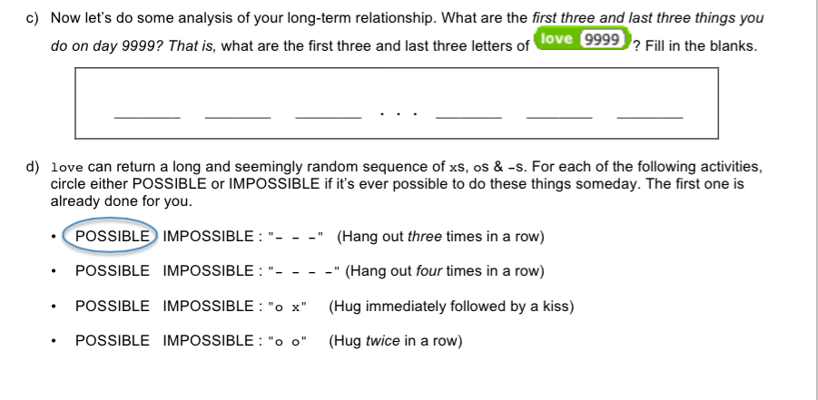
Question 14

Slide 13
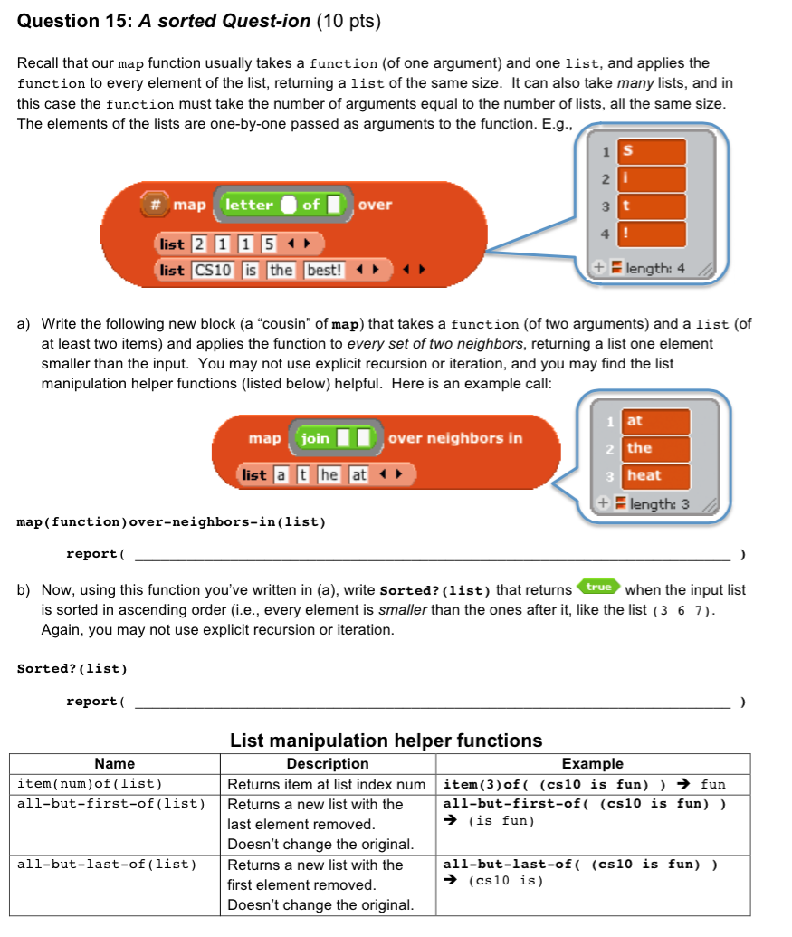
Q15

Slide 14
The Future for Future Cal Alumni
THANK YOU!
Good Luck!

